Slide 1

Success of Pain Treatment
Achal Gupta
A00258772

Slide 2
Agenda
Introduction
Measurement Scales
Success of Treatment
Further Analysis
Dependence on Age and Gender
Effect of other illness on the study
Impact of Pain on Employment Status of Patients

Slide 3

Introduction
Aim
Study Design
Random
Multi Centre
Two groups
Two Time intervals

Slide 4
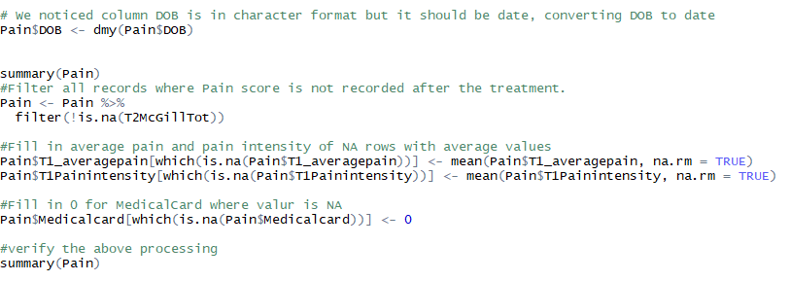
Data Cleaning

Slide 5
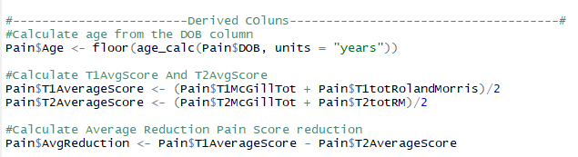
Derived Columns

Slide 6
Measuring Scales
McGill Score
Rolland Morris Score

Slide 7
Success of pain treatment
PGAP – Pain reduced by 2.78 points
2.47 points more reduction than MTAU Control Group
P-value 0.001

Slide 8
Dependence on Age and Gender
No Dependency on Age and Gender
Age – P value 0.483
Gender – P value 0.614

Slide 9
Effect of other analysis on analysis
Same population proportion of patients with other illness.
P value – 0.945

Slide 10
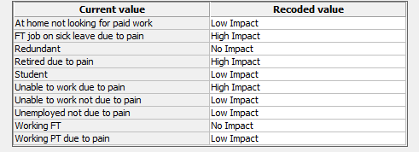
Impact of pain on Employment Status

Slide 11
Conclusion
Treatment was successful
Independent of Age, Gender and Other Illness
Pain has a high impact on employment status of Patients

